Slide 1
Topics to be Covered
Sample space and events
Finite probability spaces
Conditional Probability
Independent Events

Slide 2
Introduction to discrete probability
An experiment is a process that yields an outcome
Example
1. Rolling a dice
2. Randomly selecting five microprocessors
from a lot of 1000

Slide 3
Introduction to discrete probability
An event is an outcome or a set of outcomes from an experiment
Example
1. Obtaining a 4 when rolling a six-sided dice
2. Finding no defective microprocessors out of
five randomly chosen from a lot of 1000

Slide 4
Introduction to discrete probability
The sample space is the event of all possible outcomes
Example
1. The numbers 1,2,3,4,5,6 – all possible
outcomes when a die is rolled
2. All possible combinations of five
microprocessors selected from a lot of 1000

Slide 5
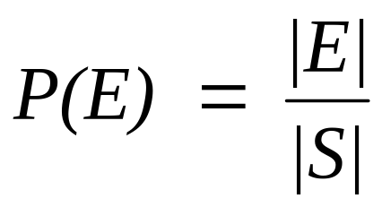
Discrete probability theory
The probability P(E) of an event E from a finite sample space S is
Assuming all outcomes are equally likely.
When all outcomes are equally likely and there are n possible outcomes, each one has a probability 1/n.

Slide 6
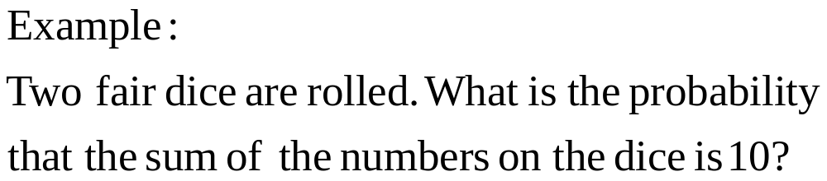
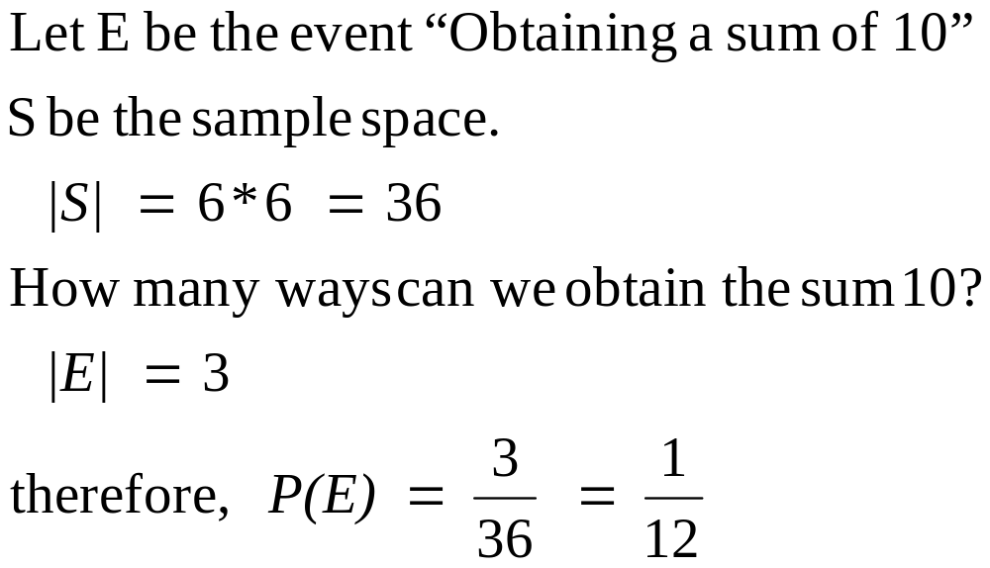
Discrete probability theory

Slide 7
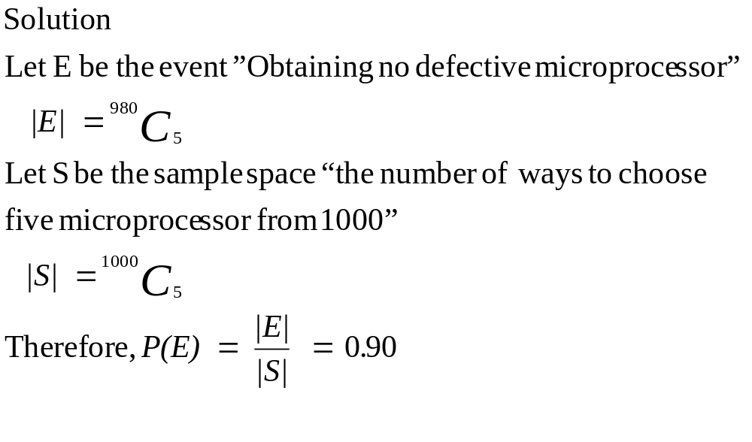
Discrete probability theory
Example
5 microprocessors are randomly selected from a lot of 1000 microprocessors among which 20 are defective. Find the probability of obtaining no defective microprocessor?

Slide 8
Discrete probability theory
When all probabilities are not equal, then some probability (possibly different numbers) must be assigned to each outcome.
We assign a probability function P(x) to each outcome x. The values P(x) need not all be the same. We call P a probability function.

Slide 9
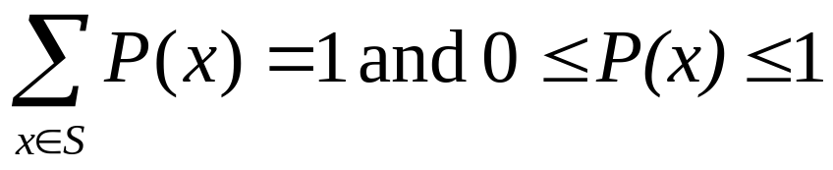
Probability function
A probability function P assigns to each outcome x in a sample space s a number P(x) so that

Slide 10
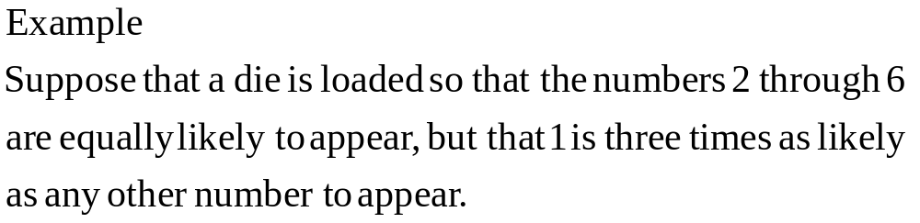
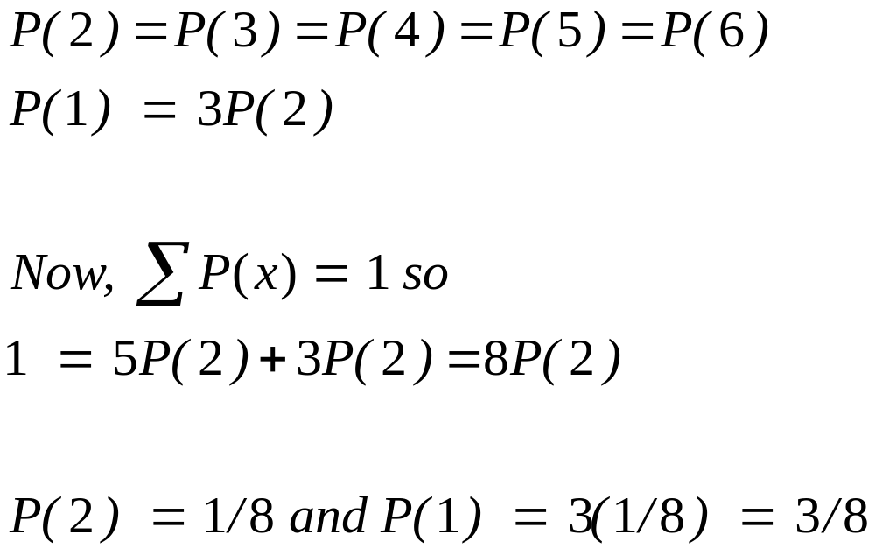
Probability function

Slide 11
Probability of an event
Given E ⊆ S, we have
0 < P(E) < P(S) = 1
If S = {x₁, x₂,…, x_{n}} is a sample space, then
_{n}
P(S) = Σ P(x_{i}) = 1
^{i =1}
If E^{c} is the complement of E in S, then
P(E) + P(E^{c}) = 1

Slide 12
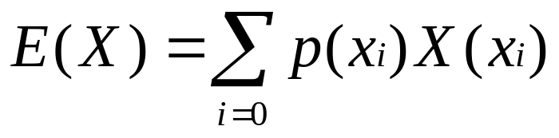
Expected Value
Given a random variable X,
the expected value is denoted by
where
x_{i} is the “i”th event or outcome of x
p(x_{i}) is the probability for the event x_{i},

Slide 13
Events in a sample space
Given any two events E₁ and E₂ in a sample space S. Then
P(E₁ ∪ E₂) = P(E₁) + P(E₂) – P(E₁∩E₂)
We also have P(∅) = 0

Slide 14
Events in a sample space
Example
Two fair dice are rolled. What is the probability of getting doubles (two dice showing the same number) or a sum of 6.

Slide 15
Events in a sample space
Let E₁ denote the event “get doubles”
E₂ denote the event “get a sum of 6”
P(E₁) = 6/36 P(E₂) = 5/36
E₁∩E₂ “get doubles and get a sum of 6”
P(E₁∩E₂) = 1/36
therefore
P(E₁ ∪ E₂) = P(E₁) + P(E₂) – P(E₁∩E₂)
= 6/36 +5/36 – 1/36
= 10/36
= 5/18

Slide 16
Events in a sample space
Events E₁ and E₂ are mutually exclusive if and
only if E₁∩E₂ = ∅. In this case
P(E₁ ∪ E₂) = P(E₁) + P(E₂)

Slide 17
Conditional probability
Conditional probability is the probability of an event E, given that another event F has occurred, is called. In symbols P(E|F).
If P(F) > 0 then
P(E|F) = P(E∩F) / P(F)
Two events E and F are independent if
P(E∩F) = P(E)P(F)

Slide 18
Conditional probability
What is the probability of getting a sum of 10, given that at least one die shows 5, when two fair dice are rolled.
Let E = “getting a sum of 10”
Let F = “at least one die shows 5”
E∩F = “getting a sum of 10 and at least one is 5”
P(E∩F) = 1/36
P(F) = 11/36
P(E / F) = (1/36) / (11/36) = 1/11

Slide 19
Topics Covered
Sample space and events
Finite probability spaces
Conditional Probability
Independent Events

